Slide 1
Intro to AR Game Design and Development
www.BrianSchrank.com

Slide 2
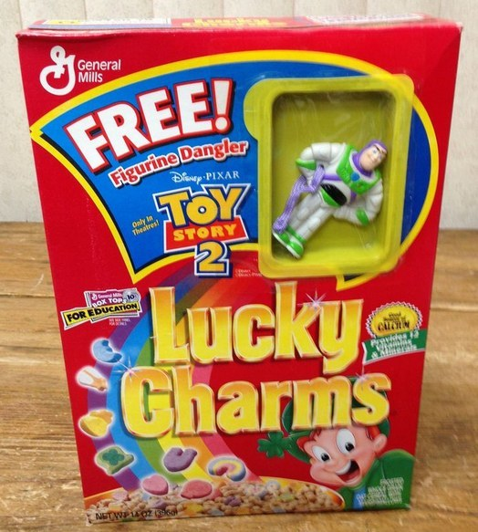
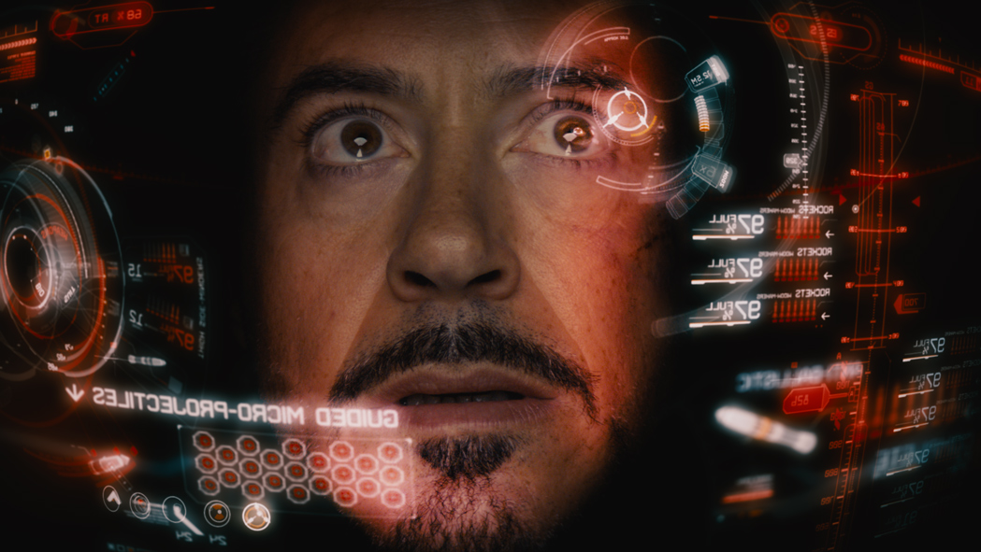
What AR is
What we want

Slide 3
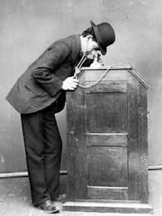
What AR is
What we want
gimmicky fun for minutes
Fully engaging human experience for hours
This took a while

Slide 4
So how can we develop for AR?

Slide 5
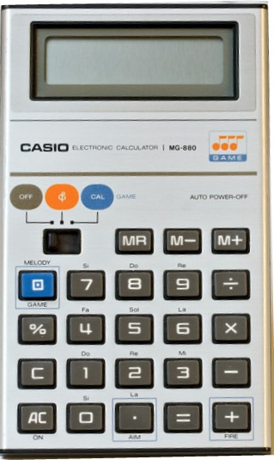
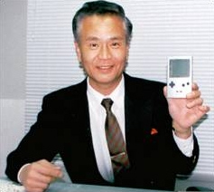
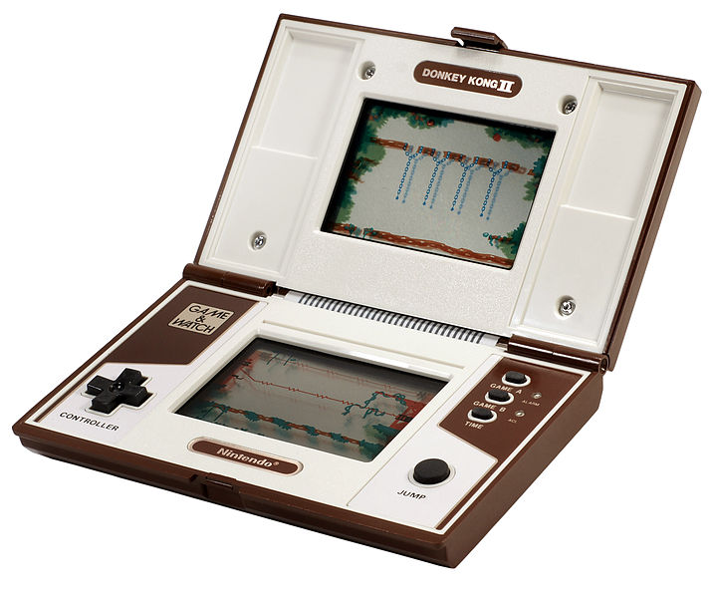
“Lateral Thinking with Withered Technology” —Gunpei Yokoi (inventor of Game Boy)
How to design play with cheap
well-understood tech?
Notes:
Yokoi saw a bored businessman playing with an LCD calculator by pressing the buttons and came up with Game & Watch and ultimately the Game Boy.
Cheap and well-understood tech

Slide 6
Lateral Thinking with Emerging Technology
Notes:
Yokoi saw a bored businessman playing with an LCD calculator by pressing the buttons and came up with Game & Watch and ultimately the Game Boy.

Slide 7
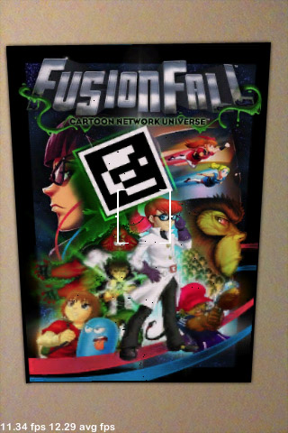
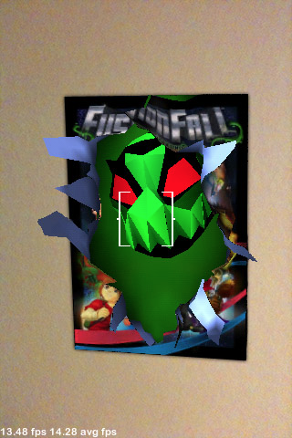
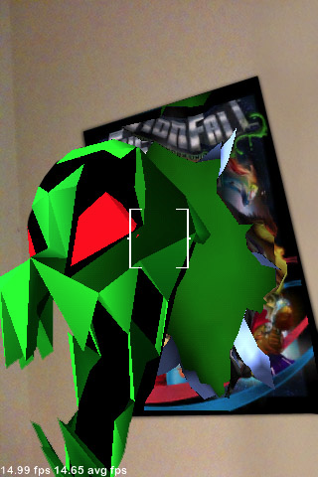
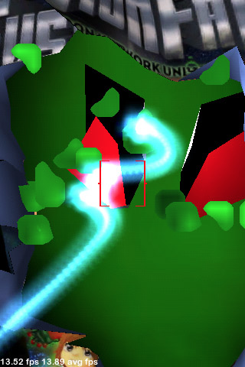
Cartoon Network / Qualcomm
Lateral Thinking with Emerging Technology
Handheld AR 2006-2010
Notes:
People don’t like holding hands up
Everything that looked cool had bad framerate

Slide 8
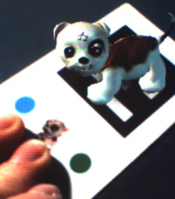
Cartoon Network / Qualcomm
Handheld AR 2006-2010
Notes:
[video]
Players enjoyed playing in the seams
The medium of AR was itself a focal point

Slide 9
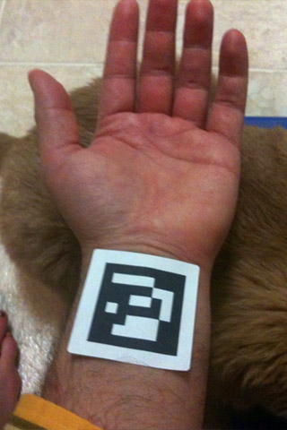
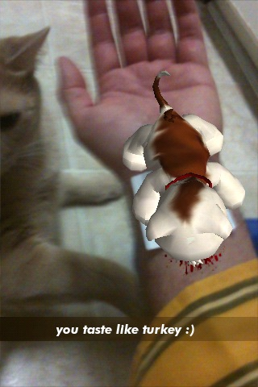
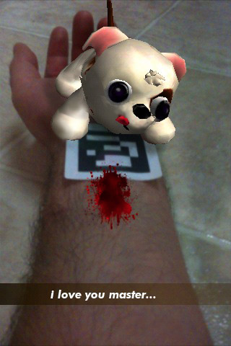
Cartoon Network / Qualcomm
Notes:
[video]
Players enjoyed playing in the seams
The medium of AR was itself a focal point

Slide 10
Cartoon Network / Qualcomm
Handheld AR 2006-2010
Notes:
[video]
Players enjoyed playing in the seams
The medium of AR was itself a focal point

Slide 11
Handheld AR works well with
Device (phone) as metaphor
Magnifying glass, fishing pole, storm cloud, etc.

Slide 12
Handheld AR works well with
Device (phone) as metaphor
Magnifying glass, fishing pole, storm cloud, etc.
Control mapping
Moving device affects focal point, bait position, wind direction, etc.

Slide 13
Handheld AR works well with
Device (phone) as metaphor
Magnifying glass, fishing pole, storm cloud, etc.
Control mapping
Moving device affects focal point, bait position
Flexible-social bodies
Players freely move, share screens, tease, etc.

Slide 14
Handheld AR works well with
Device (phone) as metaphor
Magnifying glass, fishing pole, storm cloud, etc.
Control mapping
Moving device affects focal point, bait position
Flexible-social bodies
Players freely move, share screens, tease, etc.
Virtual creatures
Little reactive creatures activate, charm the space

Slide 15
AR Game Dev DePaul

Slide 16
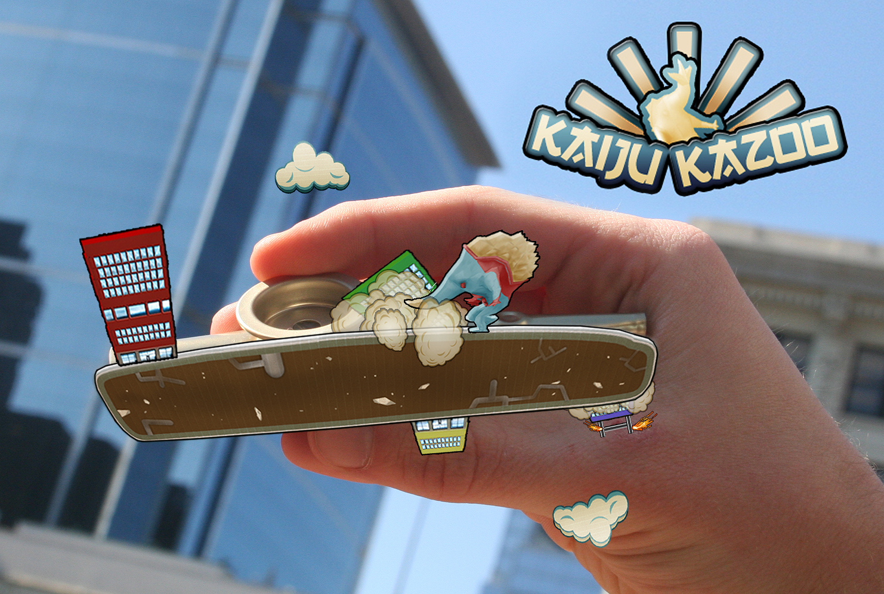
Kaiju Kazoo
Notes:
Play video
Mention / show credits
Actually encourages player to lose tracking
Play with AR itself
Uses fidelity of rotational input

Slide 17
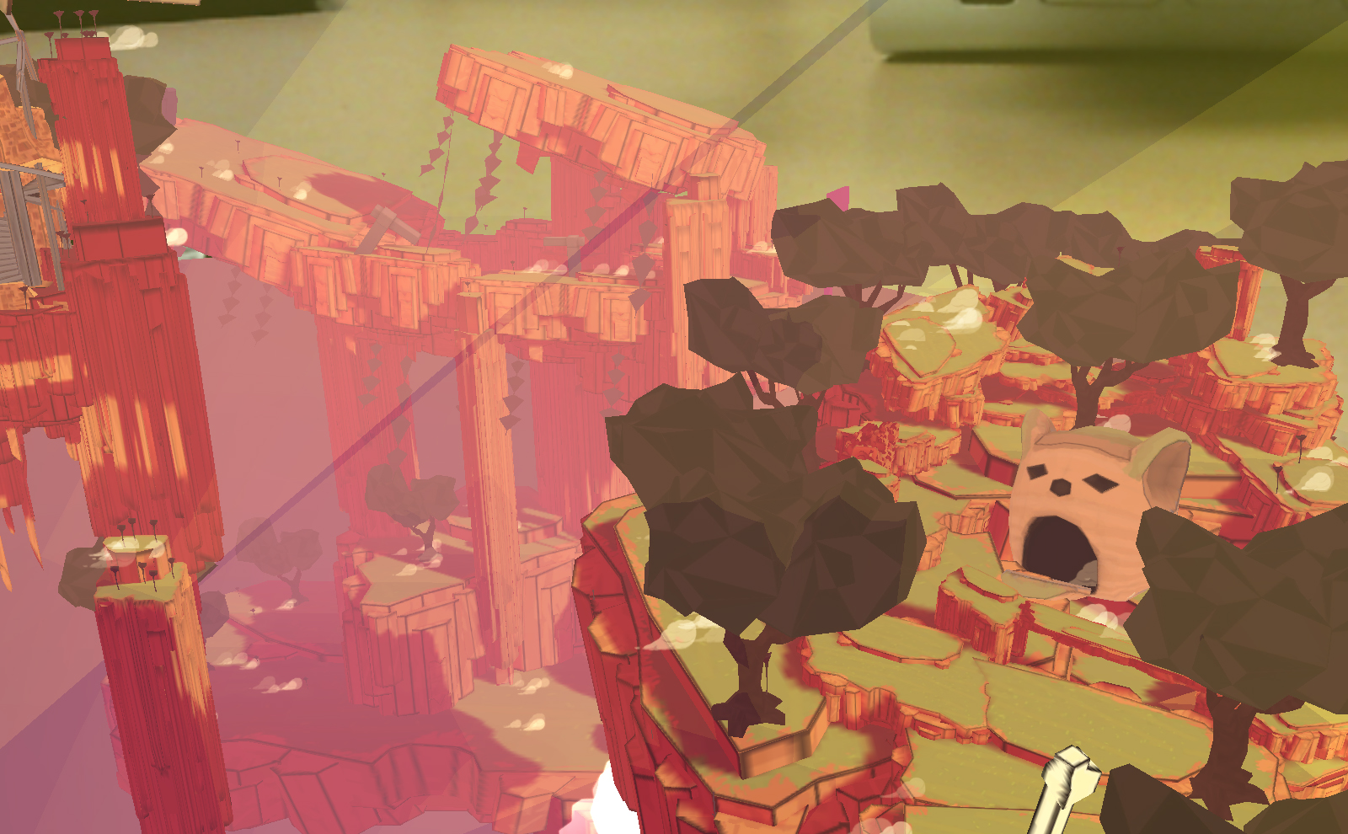
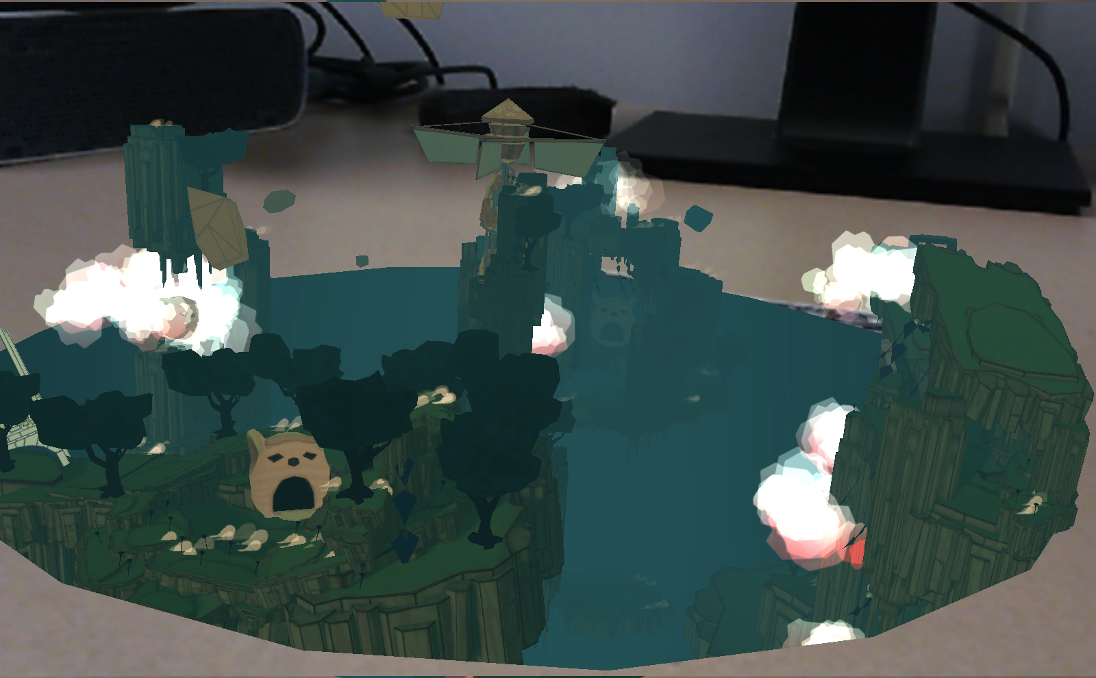
After the Gods
Notes:
Play video
Mention / show credits
Positional and rotational input
Blended contexts: vibe of gallery space + vibe of casual god game

Slide 18
Hololens Game Dev DePaul
First AR platform without any slippage
Virtual has equal presence as real
Presence vs. Immersion

Slide 19
Hololens Game Dev DePaul (Spring 2017)
First AR platform without any slippage
Virtual has equal presence as real
Presence vs. Immersion
What new kinds of play does it afford?
Device and real-world as metaphor?
Real table is also virtual boat, etc.
Flexible-social bodies as input or environment?
Your friend’s arm on table is bouncy platform, etc.
Use the limited 30° FOV as a quirky feature?
Don’t ignore the obvious flaw, play with it.

Slide 20
Hololens Game Dev DePaul (Spring 2017)
First AR platform without any slippage
Virtual has equal presence as real
Presence vs. Immersion
What new kinds of play does it afford?
Device and real-world as metaphor?
Real table is also virtual boat, etc.
Flexible-social bodies as input or environment?
Your friend’s arm on table is bouncy platform, etc.
Use the limited 30° FOV as a quirky feature?
Don’t ignore the obvious flaw, play with it.
Not
good
enough!

Slide 21
Lateral Thinking with Emerging Technology
Notes:
Yokoi saw a bored businessman playing with an LCD calculator by pressing the buttons and came up with Game & Watch and ultimately the Game Boy.

Slide 22
Lateral Thinking with Emerging Technology
What kinds of play does Hololens afford that Microsoft didn’t necessarily plan for?
Zany ideas
Whole bodies as worlds, platforms, instruments
Notes:
Yokoi saw a bored businessman playing with an LCD calculator by pressing the buttons and came up with Game & Watch and ultimately the Game Boy.

Slide 23
Lateral Thinking with Emerging Technology
What kinds of play does Hololens afford that Microsoft didn’t necessarily plan for?
Zany ideas
Whole bodies as worlds, platforms, instruments
Reckless ideas
Encouraging quick player movement across room
Notes:
Yokoi saw a bored businessman playing with an LCD calculator by pressing the buttons and came up with Game & Watch and ultimately the Game Boy.

Slide 24
Lateral Thinking with Emerging Technology
What kinds of play does Hololens afford that Microsoft didn’t necessarily plan for?
Zany ideas
Whole bodies as worlds, platforms, instruments
Reckless ideas
Encouraging quick player movement across room
Technical ideas
Any spherical object is on fire, rectangular objects spout water
Notes:
Yokoi saw a bored businessman playing with an LCD calculator by pressing the buttons and came up with Game & Watch and ultimately the Game Boy.

Slide 25
Lateral Thinking with Emerging Technology
What kinds of play does Hololens afford that Microsoft didn’t necessarily plan for?
Zany ideas
Whole bodies as worlds, platforms, instruments
Reckless ideas
Encouraging quick player movement across room
Technical ideas
Any spherical object is on fire, rectangular objects spout water
Adult ideas, theatrical ideas
Face-swapping, Mystique-play (continually changing)
Notes:
Yokoi saw a bored businessman playing with an LCD calculator by pressing the buttons and came up with Game & Watch and ultimately the Game Boy.

Slide 26
Some Notes on VR Games

Slide 27
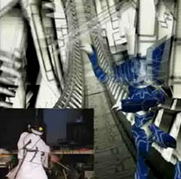
Some Notes on VR Games
Vengeance
(Fall 2003)
Notes:
Everyone knows moving fast in VR makes you sick because your sense of vision and balance get out of sync. It’s a fun rule to try to break and get away with. With this project we thought we could make the player move fast by showering them with intense rewards and distractions and keeping it super short.

Slide 28
Initial Goals of Dumpy (2013)
Invite everyone to have fun on platform
Pick-up-and-play
Identify, use unique affordances of platform
Had to feel like a “Rift” game (not just a port)
Hands-free
Only input is head rotation
Ex. Looking down with wrecking ball hanging from face

Slide 29
Notes:
Markiplier video
Go to credits on Dumpygame website

Slide 30
Developing Dumpy
Once toy was made, development was obvious: smash lots of cartoon shit...
Notes:
Once toy was prototyped and was fun right away the game asked for shit to throw at the toy

Slide 31
Developing Dumpy
Once toy was made, development was obvious: smash lots of cartoon shit...
Hitting lots of cartoon shit into other shit

Slide 32
Developing Dumpy
Once toy was made, development was obvious: smash lots of cartoon shit...
Hitting lots of cartoon shit into other shit
Setting up trunk swing mechanic to be useful in a new way every few seconds

Slide 33
Developing Dumpy
Use varied distance. Look and Aim:
NEAR: First house is in your way, forcing you to smash it and learn how trunk works
NEAR BELOW: Boys running at you
NEAR ABOVE : UFOS coming at you
MID SIDE: Ice cream truck on building
MID AHEAD: House of Bad Boys
FAR: Blimp in sky. Distant houses, cars, UFOs
Notes:
Sat down many times with Brian Gabor to brainstorm ways to use mechanic differently in space

Slide 34
Developing Dumpy
Use every direction. Look and Aim:
STRAIGHT: First bouncing soccer ball
SIDE: First Ice Cream Truck
UP: Inspiration: Inception bent city scene + Pinball
DOWN: Inspiration: Land of Lost desert scene + side hitting debris at cop cars (sort of like baseball)

Slide 35
Dumpy Art
Fill the world quick! Artists way too slow
Dumb fun creation process
Model, color, rig, animate boy in 1 minute
Bigger, dumber, and DUMBER, clear and DUMP

Slide 36
Dumpy Art
Fill the world quick! Artists way too slow
Dumb fun creation process
Model, color, rig, animate boy in 1 minute
Bigger, dumber, and DUMBER, clear and DUMP
Since I wasn’t “artist” I could do all the art fast in a really shitty way
If I spent more than “no time” on art it looked bad

Slide 37
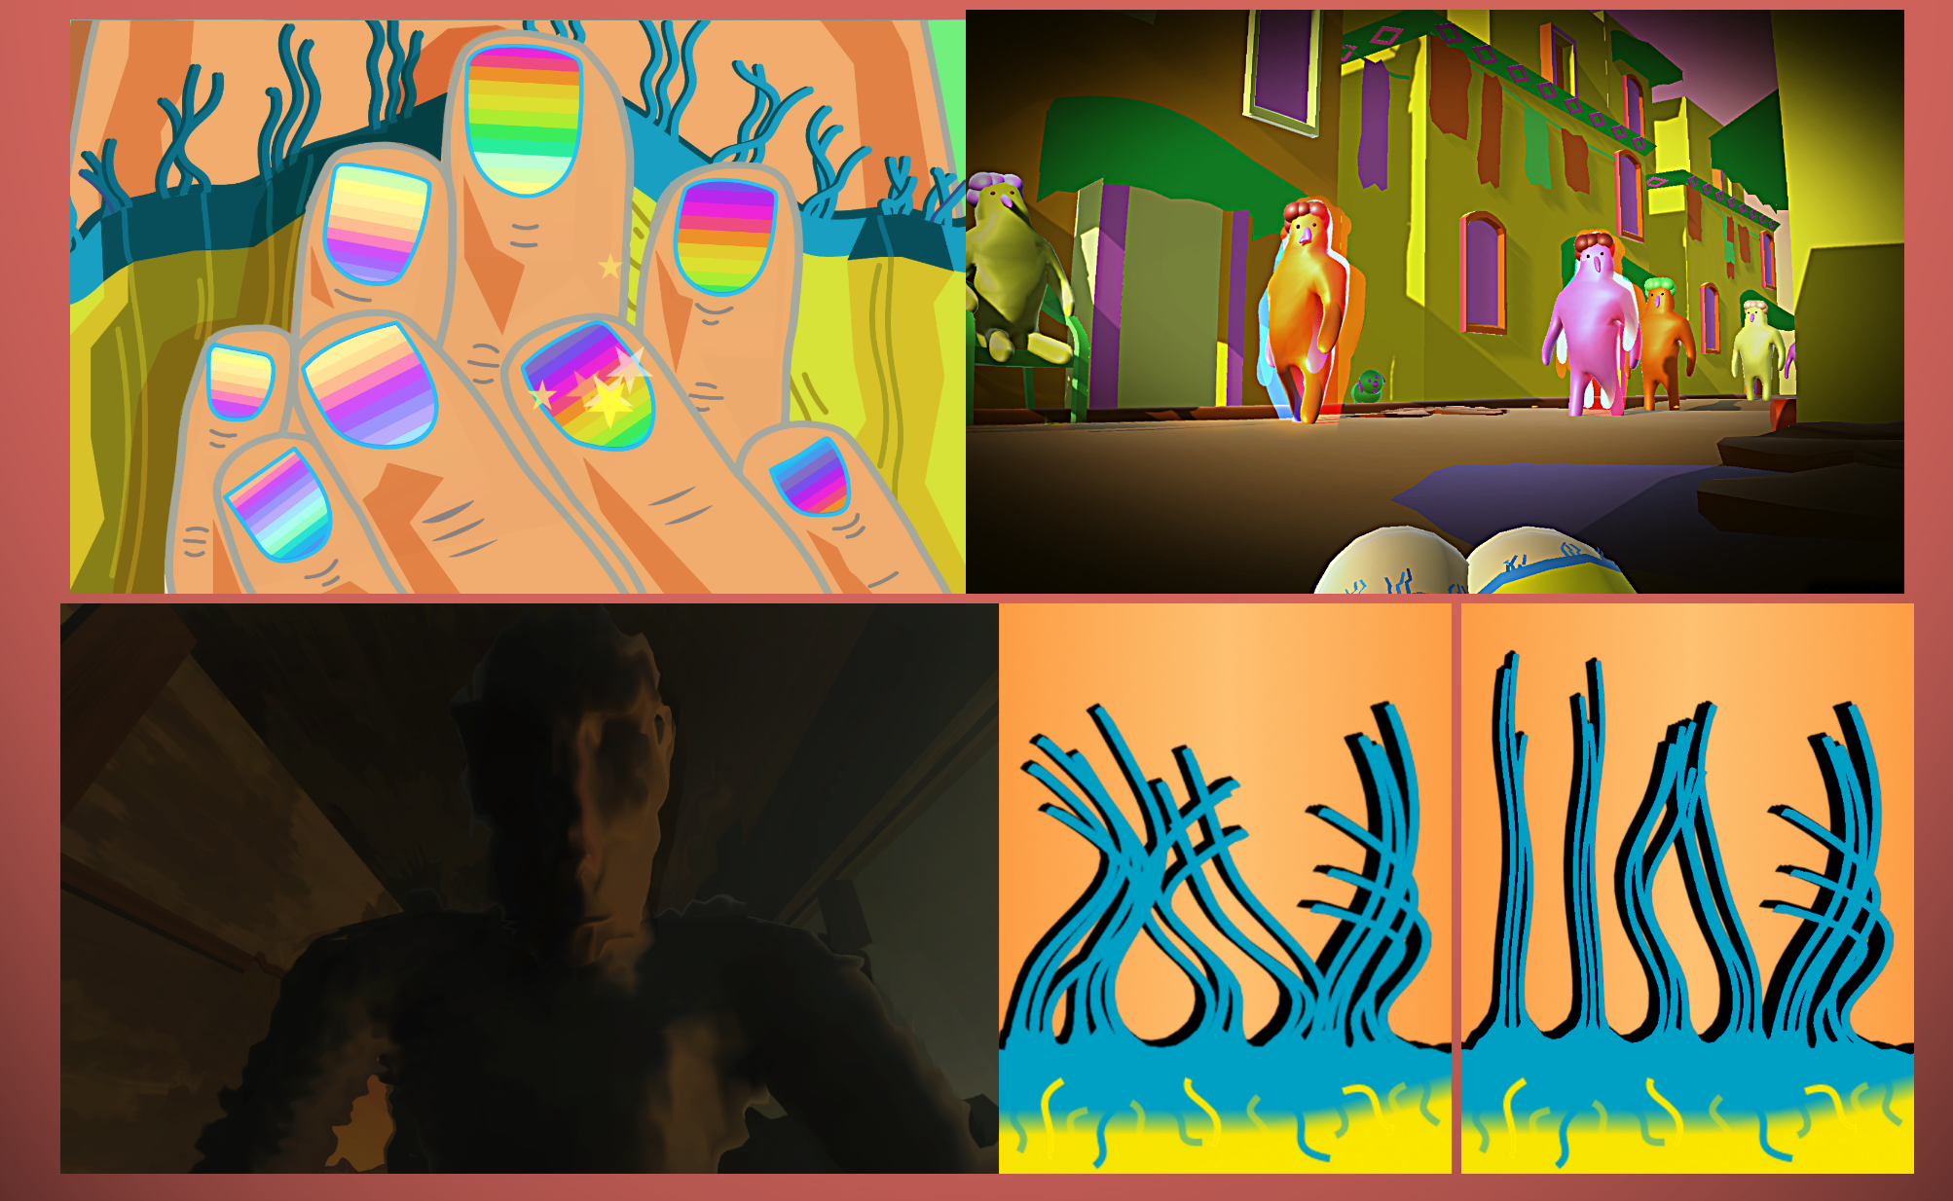
A Moment Free from Darkness
Notes:
Impressionistic 4 act game about being a sex slave
Played sequentially on 4 platforms to increase and then drop presence
Goals I had before this project:
I liked the idea of putting on VR headset for only part of game
Wanted to have player experience / see rape in a way that “worked.” Thoughtful disempowerment
Mention / show credits

Slide 38
VR Game Dev Class DePaul
Use unique affordances of VR
Strong sense of presence and embodiment
Head position and rotation
Create 3-4 very short games in 11 weeks
Immerse player in fantastic:
Bodies
Spaces
Playgrounds
Final projects

Slide 39
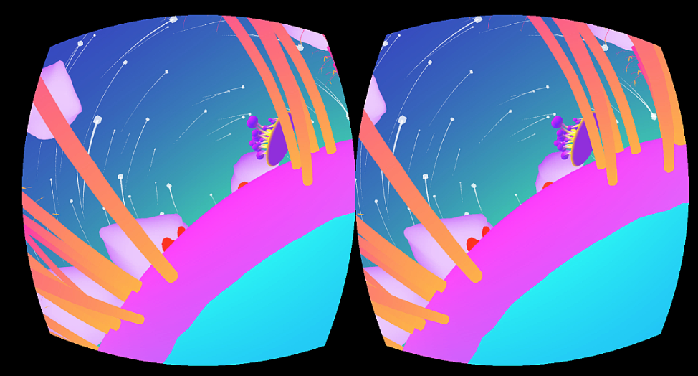
VR Game Dev Class DePaul

Slide 40
Comments, Questions?
www.BrianSchrank.com

